Slide 1


Welcome!
Sujit Molleti

Slide 2
Start Recording
Sujit Molleti

Slide 3
Efficiency Analysis
Week 13

Slide 4
What is Big 0
It is a measure of efficiency
Not relative to a specific language
Time Complexity (aka how long will a algorithm take)
Space Complexity (aka how much memory you will take)
Eliminate everything besides the most dominating variable and its degree

Slide 5
What is the big O
O(2n + 3)
O(4n^2 + 6n)
O(6n + 5n^2 * 5m)
O(5n + 6m)
O(n + logn)
O(n * logn)

Slide 6
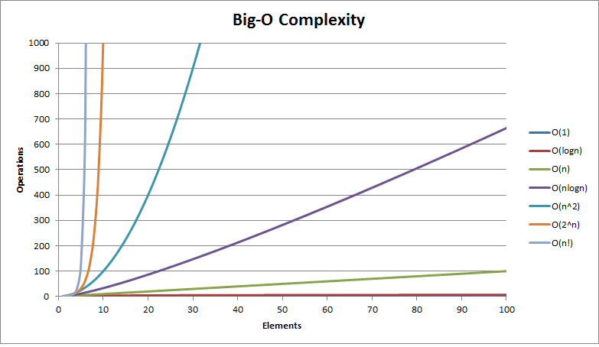

Slide 7
Problems
Week 13

Slide 8
Iterative Binary Search
What is the algorithm for binary search?
Binary Search can only be used on what type of arrays?
Trace the method above for for finding finding 2 in [1, 2, 5, 8, 15, 17]
What is the best case, worst case, and big O?

Slide 10
Big O of Gradebook
Recall the program you wrote that stored student's’ grades in a 2D array (Invalid hotlink). Each column of the array represented a different assignment, and each row represented a different student. The lowest grade was dropped and the remaining grades averaged for the final grade. All students with a 70 and above passed.
What is the big O for your program? What is the worst case, and what is the best case? Assume there is a method that calculates the average for a single student.
What is the best and worst case? What is the Big O?
Assume there is a method that calculates the average for an assignment.
What is the best and worst case? What is the Big O?

Slide 11
Let m = # of assign. Let n = # of students

Slide 12
Quiz Code: MTSP
Section 53

Slide 13
Quiz Code: TVMS
Section 19

